Slide 1
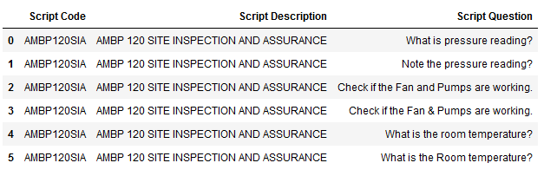
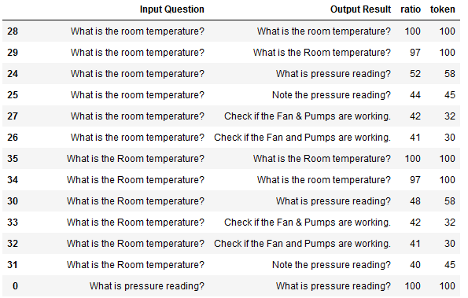
Script Rationalization – POC for DWM Project
PoC Objective – Explore the possible scenarios to find out the most similar script questions which can be rationalized using Natural Language Processing (NLP). Based on this POC this solution can be extended to all the script questions.
Input used in POC: Sample data (6 rows * 3 columns) stating various "Script Question" for different "Script Code" and "Script Description"
Approach Used –
Each question compared with a set of 6 questions one by one.
Calculate the "Ratio" and “Token” to explain the difference between the two strings.
The cartesian product of 6 script questions which produces a matrix of 6*6=36 output results
Scenarios taken care :
Questions are rephrased but are similar. For ex: Row 0 and 1 in the sample input dataset
Question has ‘&’ in place of ‘and’. For ex. : Row 2 and 3 in the sample input dataset
Cases are different but questions are similar. For ex: Row 4 and 5 in the sample input dataset
Output:
Based on the Ratio and Token we select the top two records as they are most similar to the Input Question
From the top two records the best fit will need to be selected by the Business. – This will depend on accuracy of this predictive model.
Best Fit question will then be used further.

Slide 2
Script Rationalization – POC Outcomes
Benefits of this Approach used in POC -
This will enable the script question rationalization using Python.
Ease of Usability for Business and non technical users
Time and hence Cost savings
Reusability of code for any use-case involving string comparisons
Support the T-shirt sizing activity as this will help to make informed decision on the complexity of work with regards to each Script.
Alternative Approaches : Two other approaches that can also be considered:
Partial ratio - Calls ratio using the shortest string (length n) against all n-length substrings of the larger string and returns the highest score
Token set ratio - Calls ratio on ‘n’ particular substring sets and returns the max ratio .

